Slide 1




Y20 PLACEMENT ANALYSIS
INSTRUCTOR : Dootika Vats
TEAM MEMBERS
A. Atulya Sundaram
Anjali Kumari
Saurav Raj
Shreyasi Kayam

Slide 2

INTRODUCTION
Objective: Analyse Y20 Placement Data for Trends and Visualize
Why? : “IIT jaoge toh life set hai”
Help Future Batches
How?
Placement Data: https://spo-backend.vercel.app/
Student Data: https://search.pclub.in/

Slide 3
KEY QUESTIONS
Placement Rate?
Branch-wise
Gender Wise
State Wise
Average CTC?
Across all groups
Gender Bias?
Are girls more likely to get placed?

Slide 4
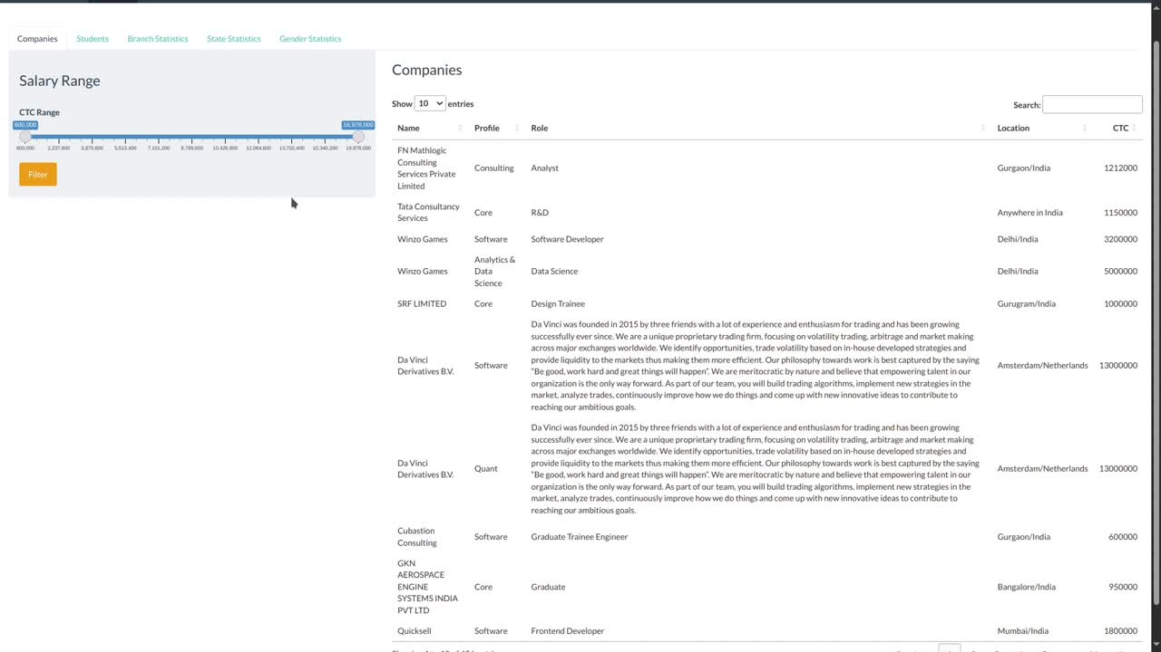

Slide 5
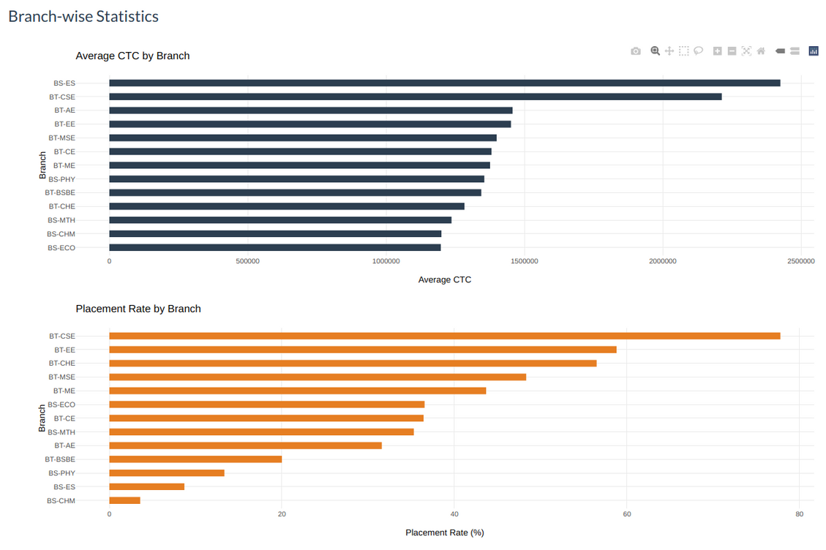
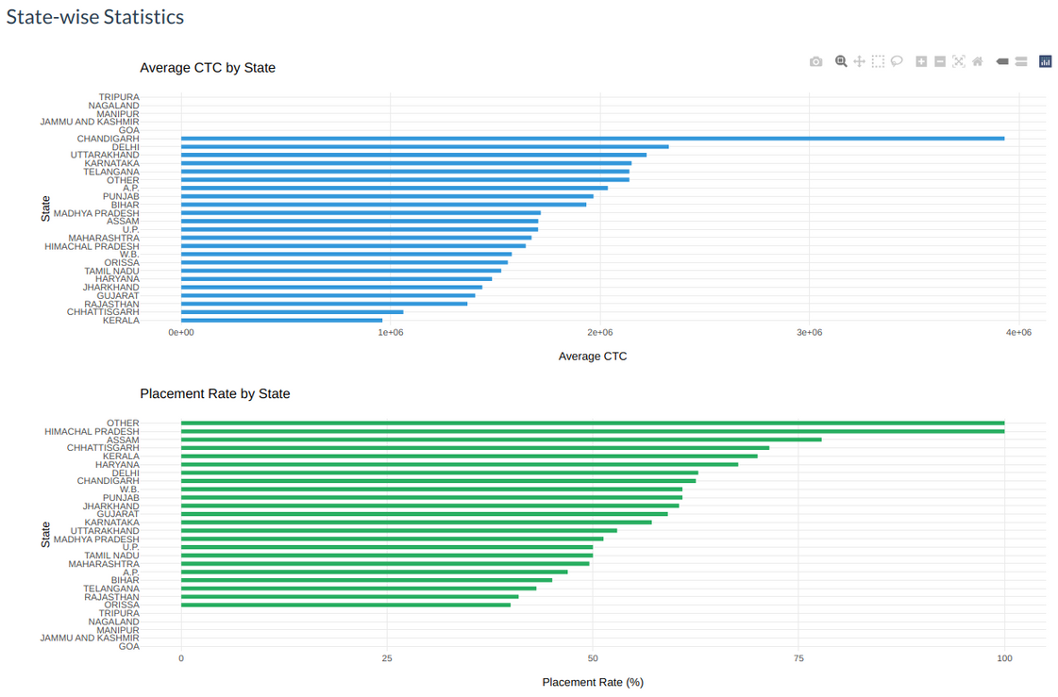
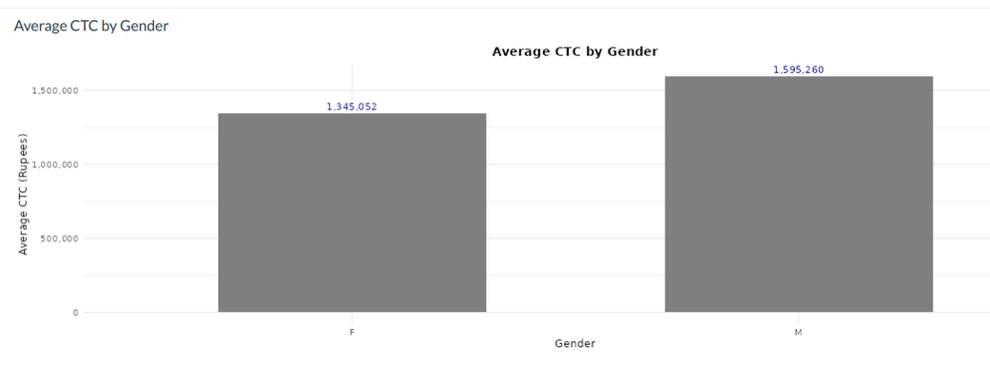
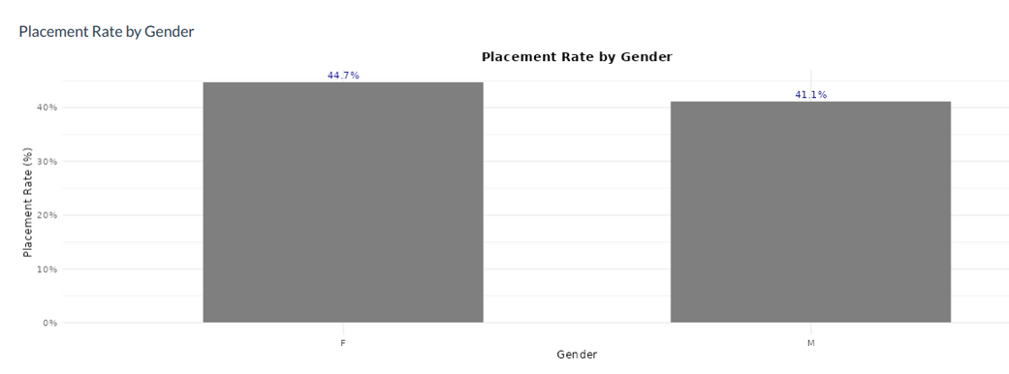

Slide 6
FUTURE IMPROVEMENTS
Over more batches - not only Y20
CPI based analysis - too personal
Skill based Analysis - Coding, Leadership, etc.
More focus on Profiles - Quant, Consult, Core, Analytics,
Global correlation with Market trends (advanced)
Placement location based analysis

Slide 7
THANK YOU
SO MUCH

